Slide 1

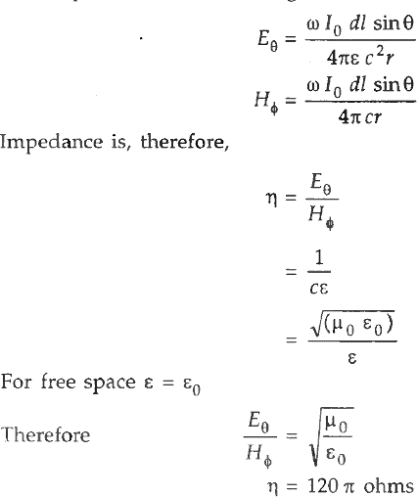
Antenna and Wave Propagation Electromagnetic Spectrum
Characteristic Impedance
The amplitude of the radiating fields is:-
So, the radiating wave has the same impedance as the free space impedance of 120 𝜋 ohms and hence the radiating field is matched into the free space impedance for maximum transfer of power.
1
Main Ref. 1) A. K. Gautam. ''Antenna and wave propagation ''
2) Balanis. "Antenna theory: Design and analysis"2nd edition

